Slide 1

Cybersecurity Club:
Empowering students with cybersecurity skills and opportunities.

Slide 2

Club Leadership
President:
Vice Presidents:
Secretary:
Zoe Flam
Dennis Freyman &
Isaac Lemieux
Jason Zhang
Treasurer:
Chair of Community:
Webmaster:
John Tien
Maia Rocha
Yash Jha

Slide 3

Our Mission
1
Educate
Empower students with cybersecurity knowledge and skills.
2
Protect
Promote a strong cybersecurity culture.
3
Provide
Offer resources and opportunities for competition and recognition.

Slide 4
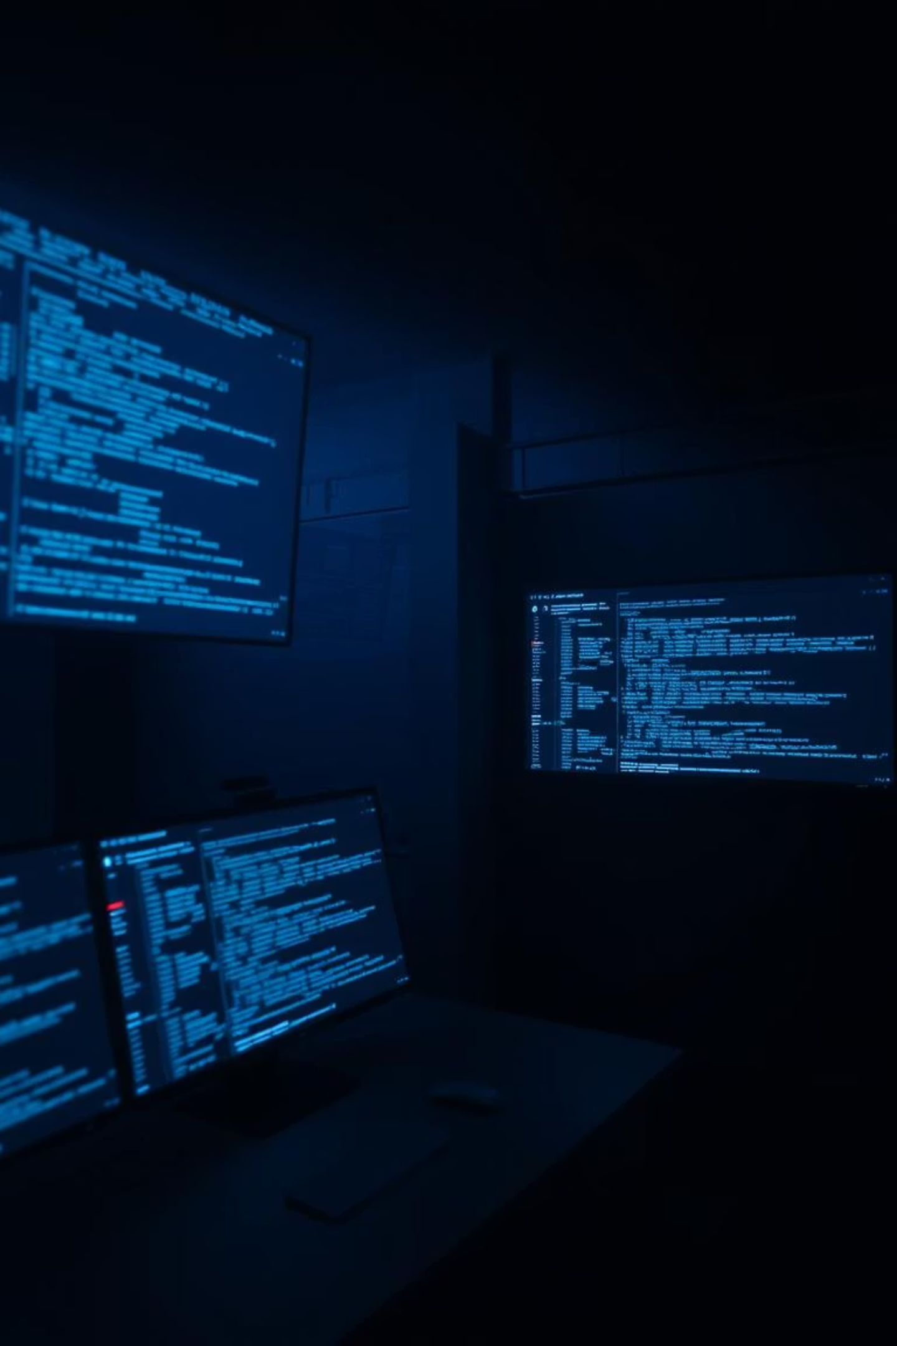
Club Activities
Presentations
Competitions
Leadership and guest speakers provide regular presentations on cybersecurity topics.
The club hosts both defensive and offensive cybersecurity competitions and Capture-the-Flag (CTF) events.

Slide 5
Club Activities Cont.
Projects
Outreach & Awareness
The club works on interesting projects related to cybersecurity.
We participate in events like STEM/STEAM nights to share our knowledge of cybersecurity.

Slide 6
Competitions
CyberPatriot
NCL
Other CTFs
Team-based. Main yearly competition. Defensive, securing machines.
Team-based. Offensive competition in the fall.
Other smaller competitions which pop up throughout the year.

Slide 7

Some things to look forward to:
Learning Materials
Learn advanced cybersecurity topics like penetration testing and app hacking.
Tools
Access high-end penetration testing tools.
Certifications
Earn scholarships and valuable certifications (up to $9000).

Slide 8
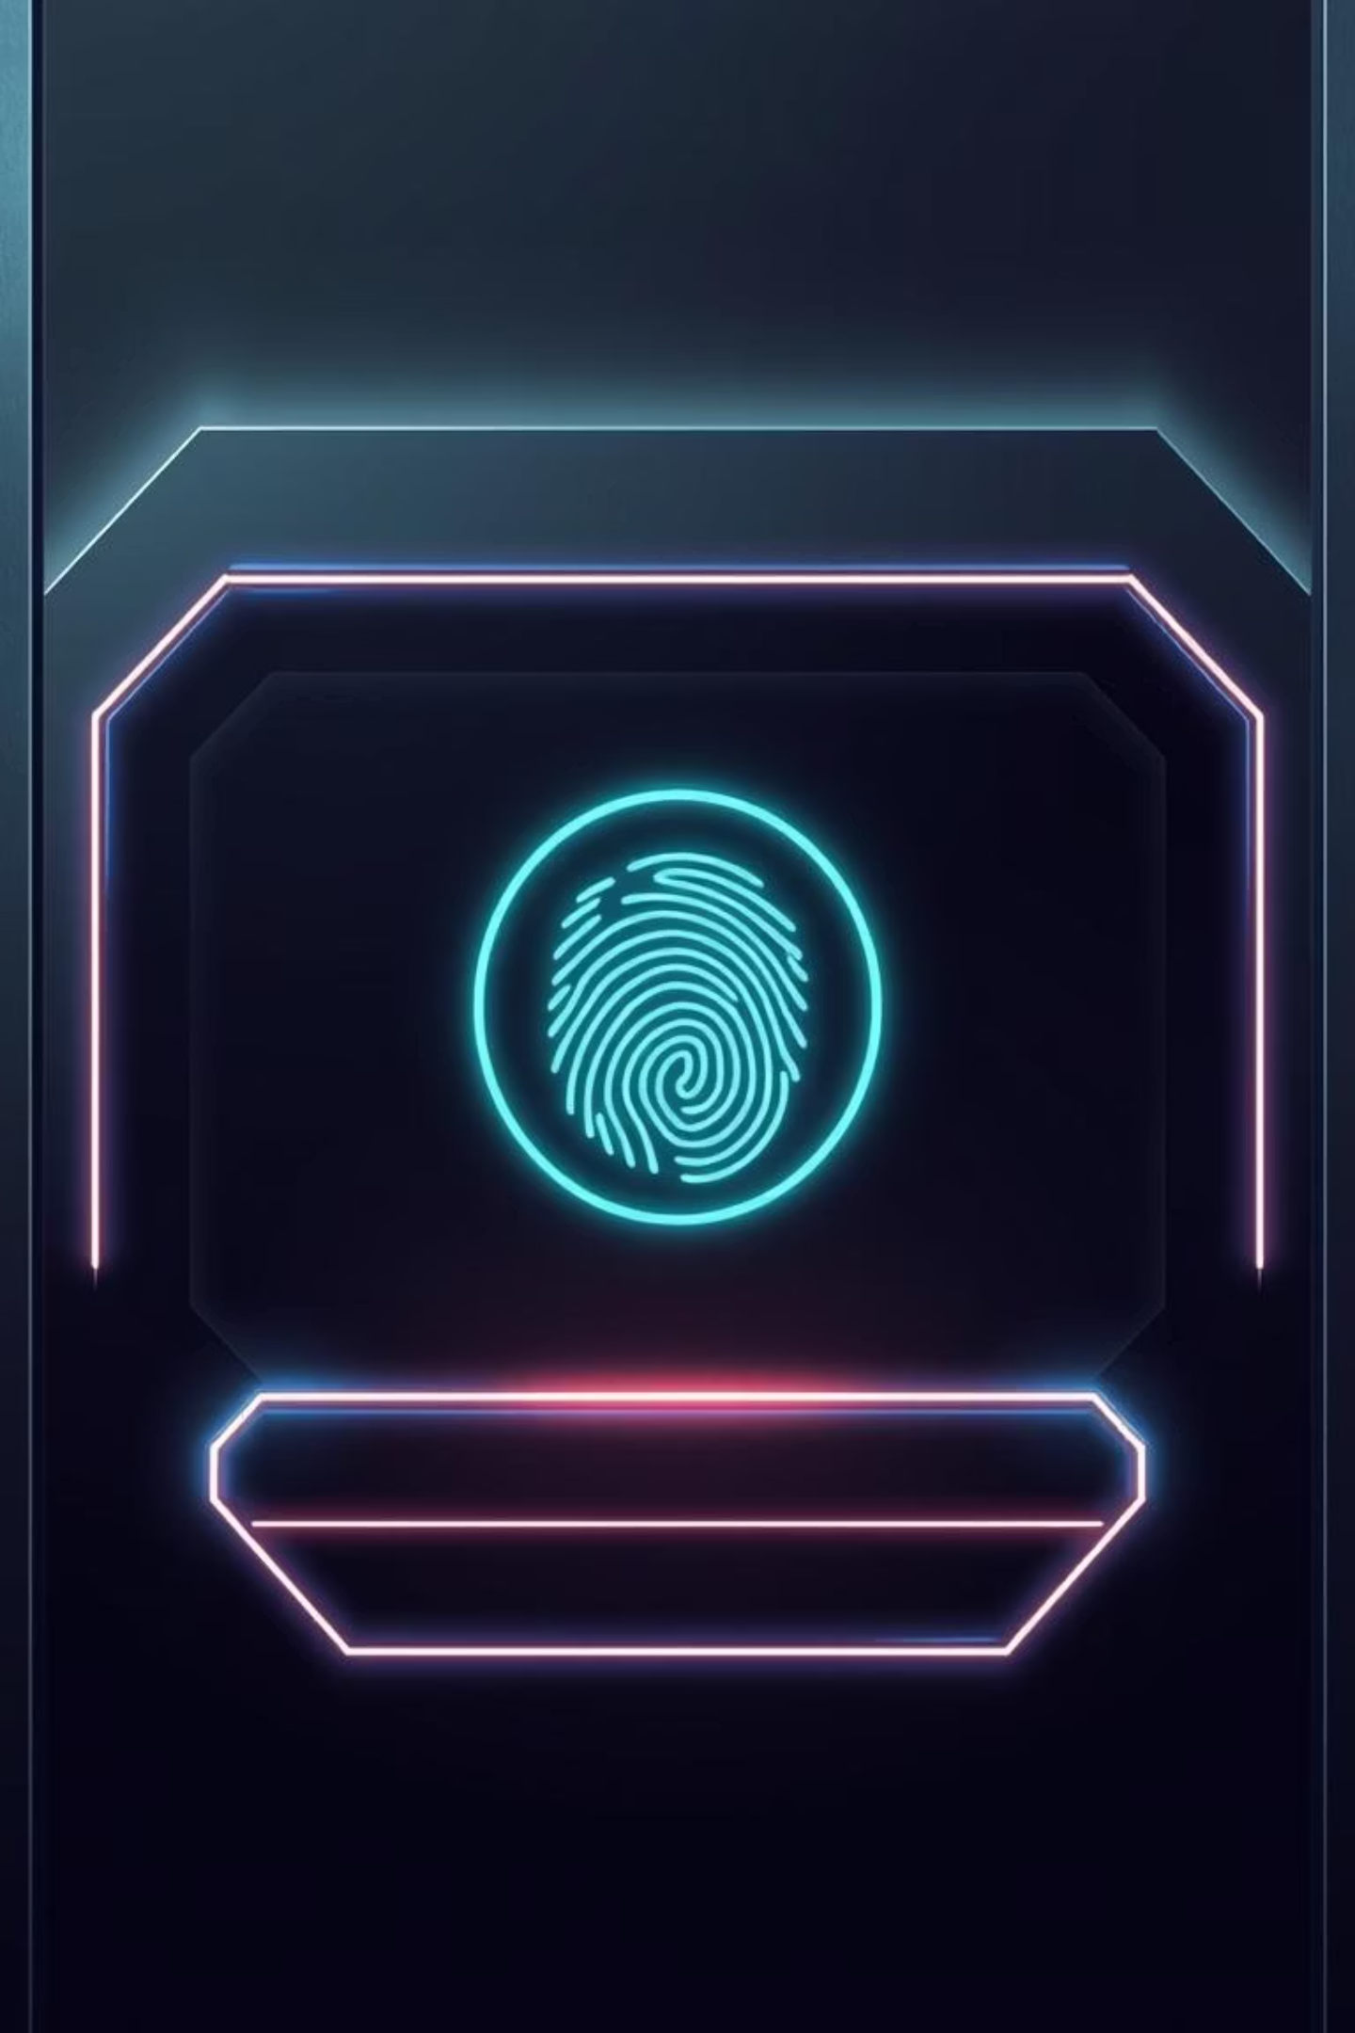
Join Cybersecurity Club
Join GroupMe
Use QR code provided
Fill Out Registration
Registration is required to become a member.
Engage & Grow
Participate and learn cybersecurity.

Slide 9
Thank You!
Thank you for taking the time to learn about the Cybersecurity Club. We hope to see you next week!

